Slide 1

Final Project
e-commerce
mern stack
Reg No - DEH/IT/2022/F/0043
Name - Sanjith N

Slide 2



05.08.2025
e-commerce
DEH/IT/2022/F/0043
Sanjith N
Trends, Opportunities & Future Outlook

Slide 3


limited Customers
Manual handling
limited reach
Limited Ecommerce sites
Non tech idea
Why ?

Slide 4


what is ..
e-commerce
Definition
Buying and selling goods/services online.
Key platforms
Amazon
AliExpress
Daraz
Ebay
Types
B2C, B2B, C2C, C2B
Rapid global growth due to technology and internet access.

Slide 5


Scalable
24/7 availability
Global reach
Lower operational costs
Easy customer insights through data
Personalized shopping experiences
Secure
benefits of
e-commerce

Slide 6


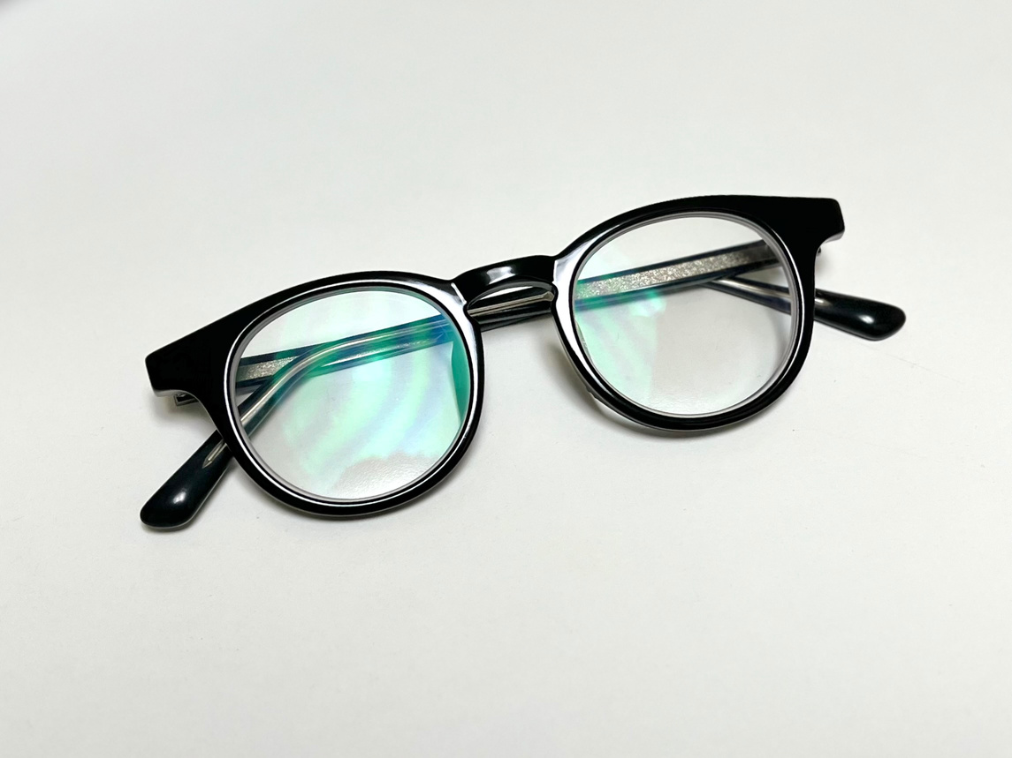



System
Architecture
Frontend (React + Bootstrap)
Backend (Node.js + Express)
Database (MongoDB)
Payment gateway (Stripe)

Slide 7


features
key
Admin side:
User side:
Manage products
Register/login
view users & orders
browse & filter
add to cart, checkout
Common
Product reviews
ratings

Slide 8
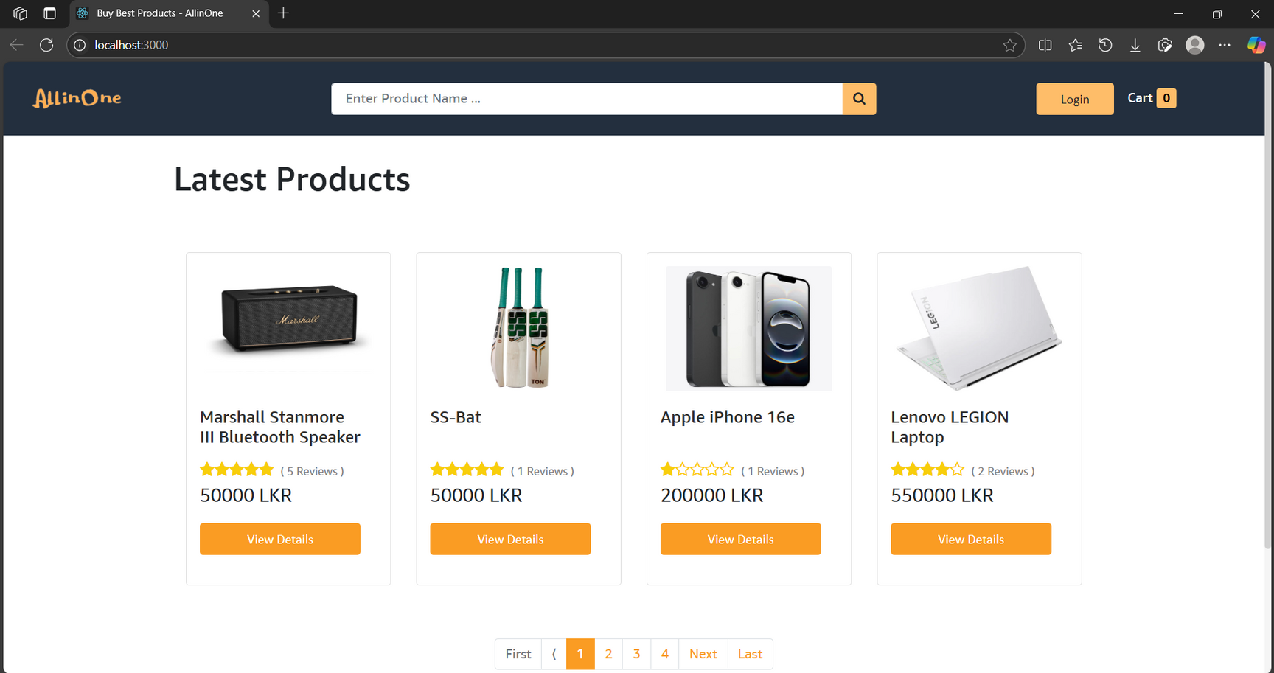
Home Page
e-commerce

Slide 9
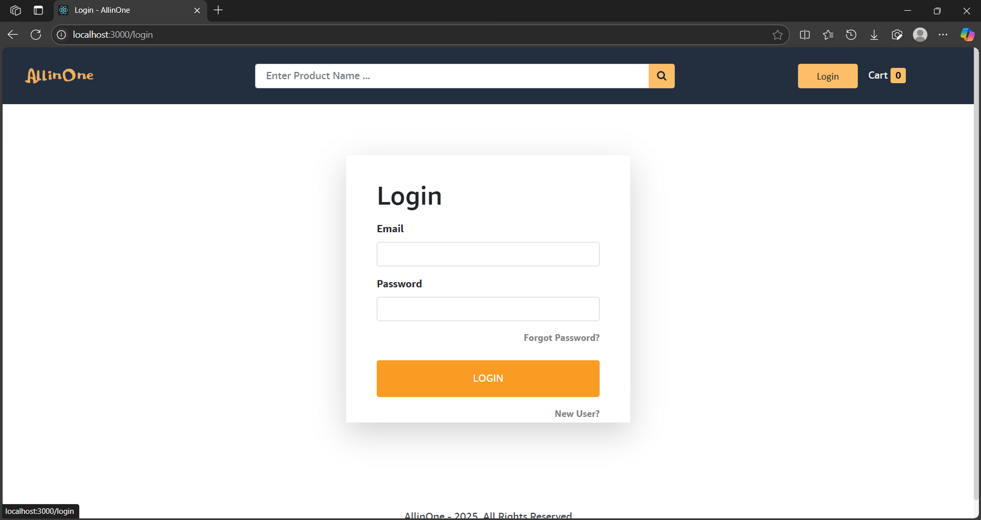
Login Page
e-commerce

Slide 10
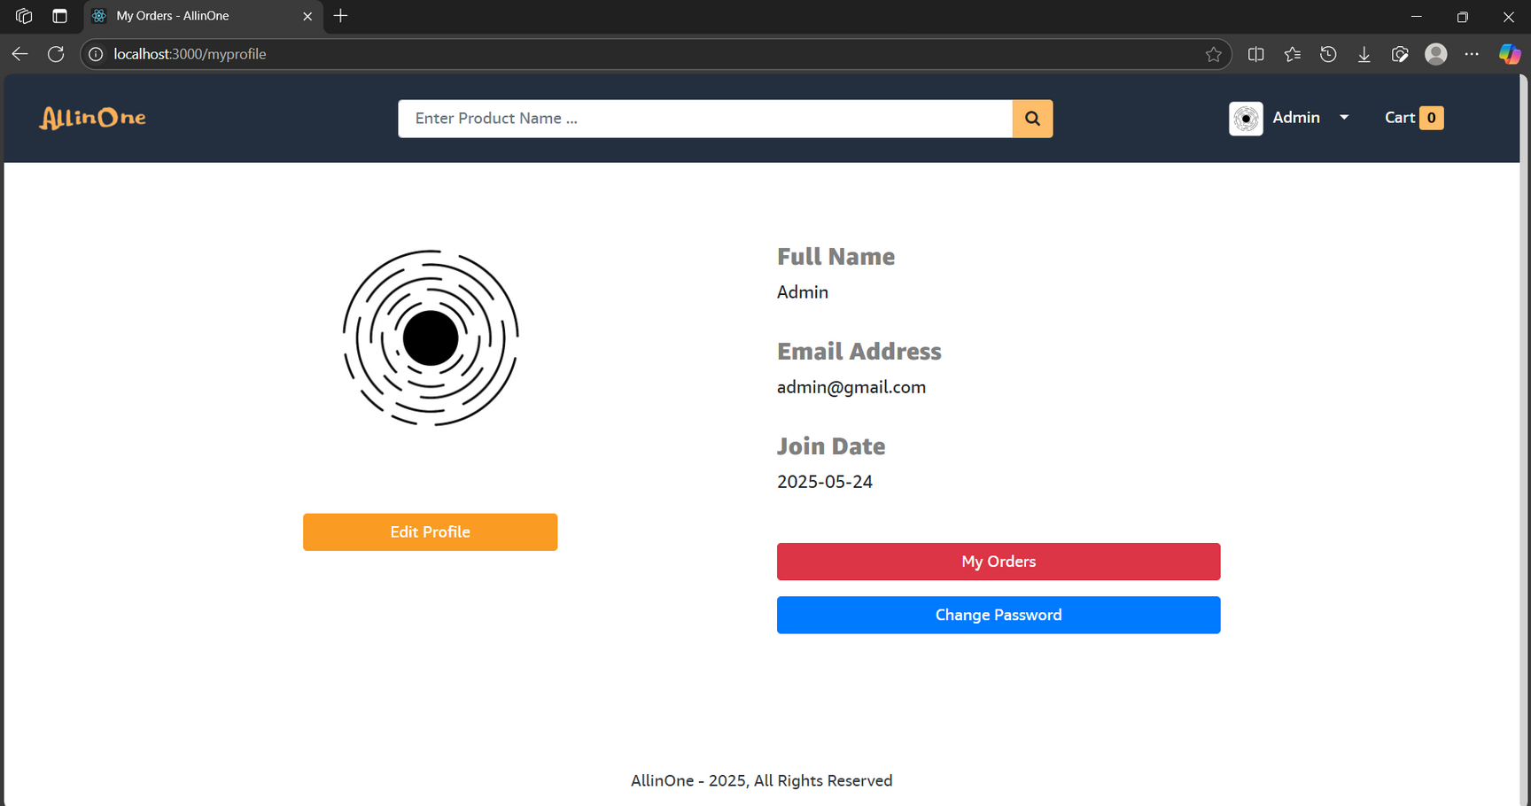
Profile Page
e-commerce

Slide 11
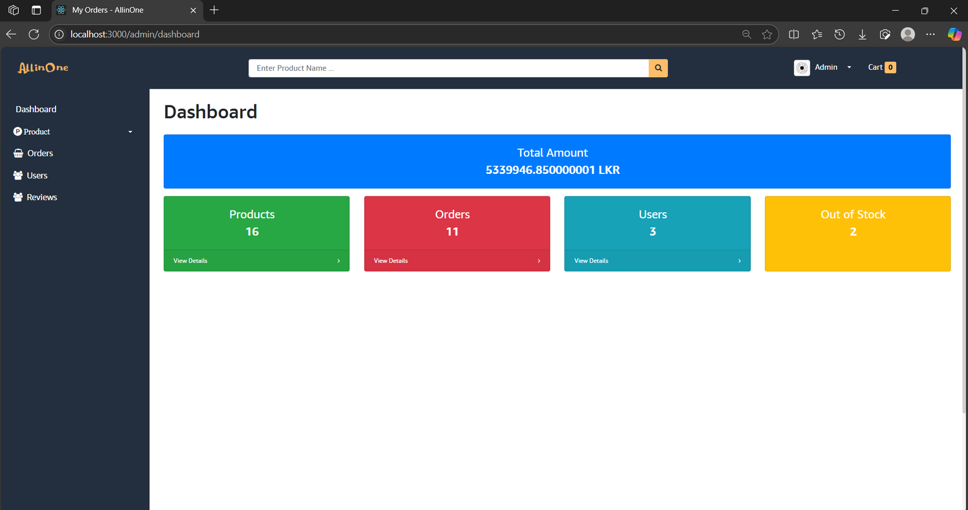
Admin Page
e-commerce

Slide 12

challenges in
e-commerce
Integrating Stripe
managing JWT authentication
Making perfect UI
Time and cost management
Testing and error handlings

Slide 13


e-commerce
Future of
AI-based recommendations
Native mobile apps
Analytics dashboard
Multi-Vendor Marketplace Support:
Instant delivery (
1-hour, drones)

Slide 14


Final Thoughts
Conclusion
Project meets its goal
What I learn ?

Slide 15


q & a
any questions?
https://sanjith.vercel.app/
+94 767 9596 24
sanjithnagaraja@gmail.com

Slide 16
Thank You !
DEH/IT/2022/F/0043
https://sanjith.vercel.app/
+94 767 9596 24
sanjithnagaraja@gmail.com

